Slide 1
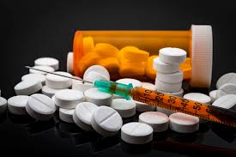


Neuroimaging to Inform Clinical Practice in
Treatment of Substance Use Disorders
Edythe D. London, Ph.D.
2018 Integrated Care Conference
LA County Department of Mental Health and
Substance Abuse, Prevention and Control
October 25, 2018

Slide 2
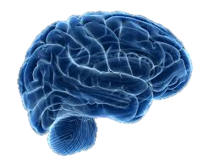
Goals in Clinical Practice
Treatment engagement
Self-awareness
Reduction and management of craving
Mood regulation
Improve decision-making
Brain Integrity and Function

Slide 3
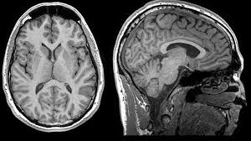
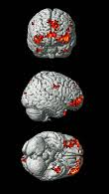
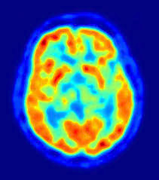
Brain Imaging Modalities
MRI scan functional MRI
PET Scan
Gray- and White-Matter Structure
Biochemistry Molecular Dynamics
Brain activity

Slide 4
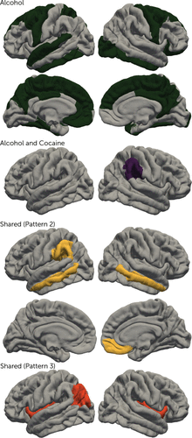
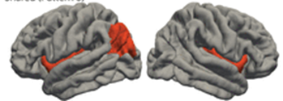
What Have We Learned?
Gray Matter Volume in Addiction
23 laboratories, 3,240 individuals: 2,140 with substance dependence:
alcohol, nicotine, cocaine, methamphetamine, cannabis
alcohol
general patterns
smaller volume/thickness in many brain regions
greatest effects linked to alcohol
some general effects:
insula
medial orbitofrontal cortex
Scott Mackey and the ENIGMA Addiction Working Group
Am. J. Psychiatry 2018

Slide 5
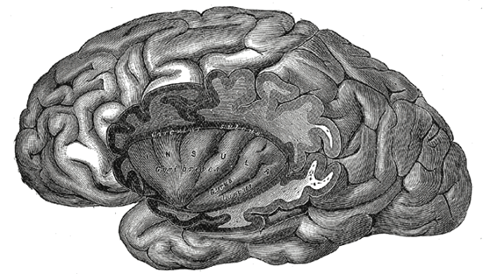
What Does the Insula Do?
An island of cortex tucked inside the lateral sulcus
considered part of the limbic system
role in self-awareness, body representation
subjective emotional experience
important in decision-making
(including decisions involving risk)
Activated by pain, love, emotion, drug craving, addiction, enjoyment of music, tasting of wine.

Slide 6
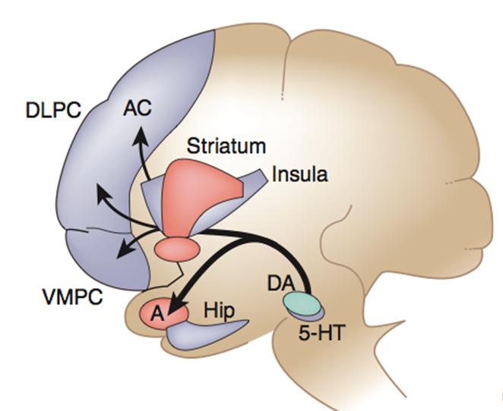
What Does the Insula Do?
An island of cortex tucked inside the lateral sulcus
considered part of the limbic system
role in self-awareness, body representation
subjective emotional experience
important in decision-making
(including decisions involving risk)
Activated by pain, love, emotion, drug craving, addiction, enjoyment of music, tasting of wine.
Linked to important brain regions:
Thalamus - Sensory
Amygdala - salience, emotional memories
Anterior Cingulate and Prefrontal cortex
– attention, impulse control
Striatum – goal-directed action

Slide 7
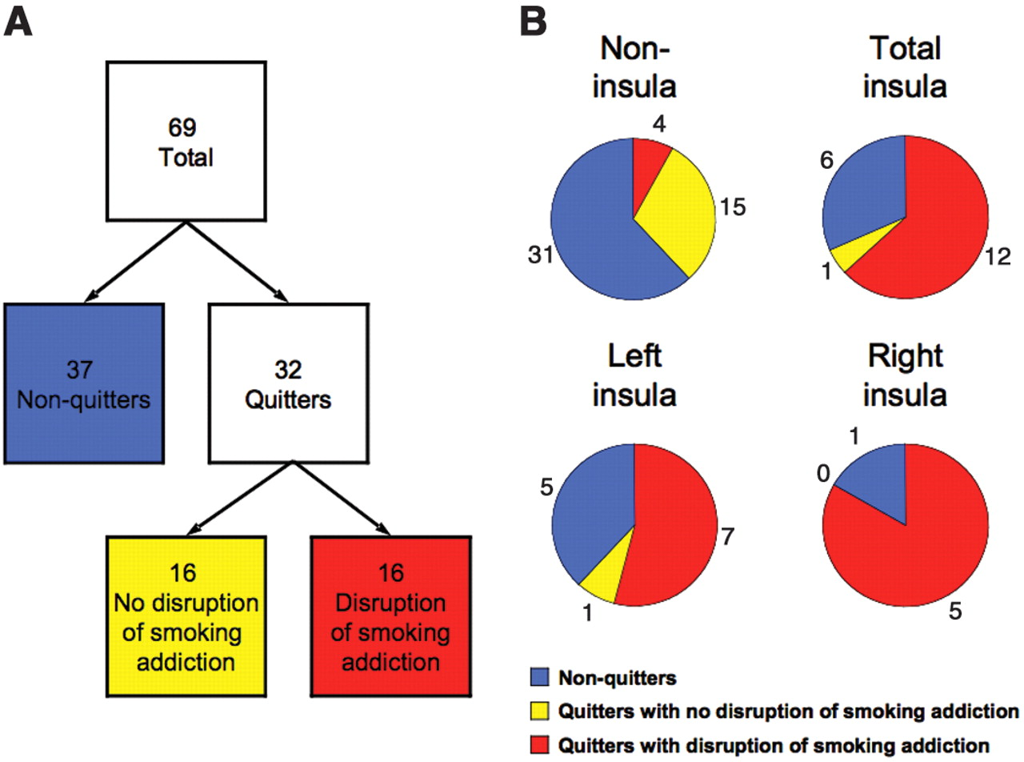
Insula Damage Disrupts
Addiction to Cigarettes
Insula
Stroke
69
total
Non-insula
Stroke
4
6
37
Non-
Quitters
15
12
32
Quitters
31
1
Left
Right
16
Resumed
Smoking
16
Maintained
Abstinence
1
5
7
5
1
N.H. Naqvi et al., 2007

Slide 8
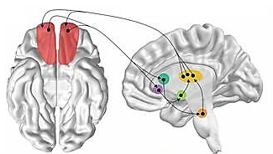
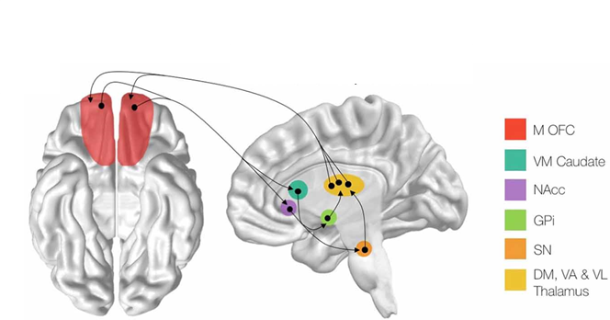
What Does the Medial Orbitofrontal Cortex Do?
Medial OFC
Caudate
Accumbens n.
Globus pallidus
Substantia nigra
Thalamus
It is well-connected to brain regions linked to:
sensations, perceptions of outside world
Stimulus-response associations/action
Major function in decision-making
-regulates sensitivity to outcome value

Slide 9
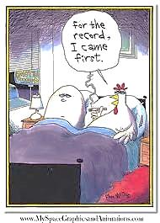
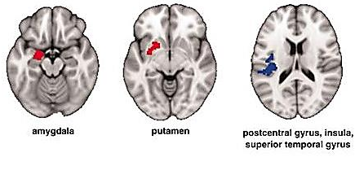
What Came First?
Do Structural Differences Reflect Addiction Vulnerability?
Stimulant abusers and nonaddicted siblings
differ from non-drug-users.
Larger
Amygdala: emotion
Putamen: habit formation
Smaller
Insula:
decision-making
internal states
K. Ersche et al., 2012: Science 335,601

Slide 10
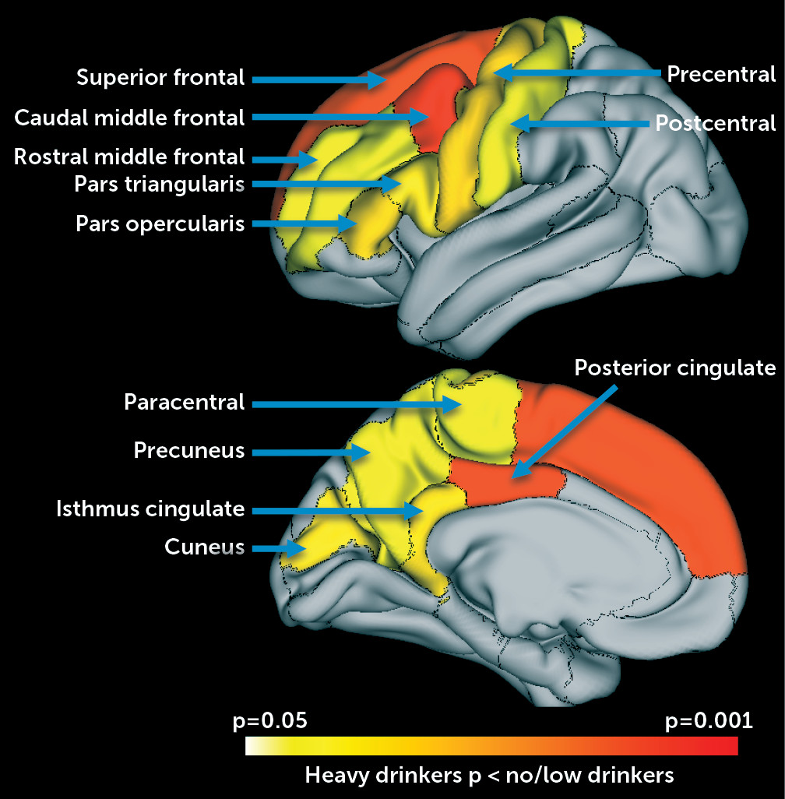
Altered Brain Development in
Adolescents After Initiating Drinking
483 adolescents (12–21 y)
before initiation of drinking
At 2 years:
356 - no/low alcohol use
65 - moderate drinking
62 - heavy drinking.
Reductions in gray matter volume: heavy > no/low drinkers
Bright orange: regions with faster declines (p<0.025).
A. Pfefferbaum et al., Am. J. Psychiatry, 2018

Slide 11
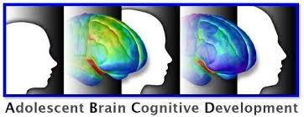
The ABCD Longitudinal Study
largest long-term US study of brain development and child health
21 sites: ~ 10,000 children (9-10 y)
following into early adulthood
structural and functional brain imaging, genetics, neuropsychological, behavioral, other health assessments

Slide 12
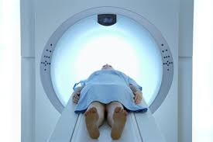
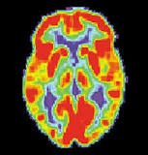
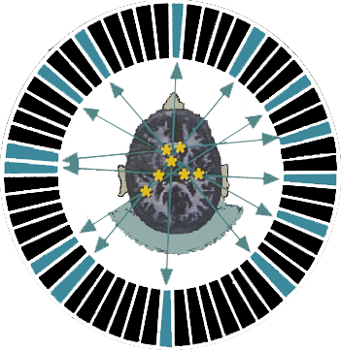
Brain Function Studied with PET picturing a slice of activity
Participant receives
injection of
a radioactive tracer.
Brain image reflects neural function, neurotransmitter dynamics.
Computers reconstruct
image of where the
tracer accumulated.

Slide 13
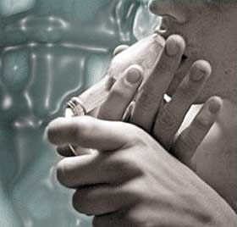
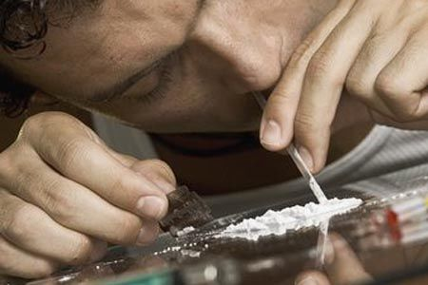
Cocaine Craving Studied Using Videotapes to Remind the Participant about Cocaine
Participants rate cocaine craving during PET Scans.

Slide 14
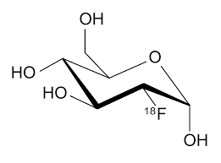
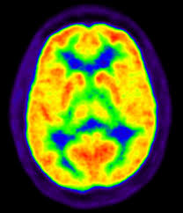
Brain Function During Cocaine Craving
PET Scanning
[¹⁸F]fluorodeoxyglucose
-- radiotracer for
brain function
Glucose metabolism
visualized with PET
Cocaine-related cues

Slide 15
Craving Correlated with Prefrontal Cortex and Amygdala Activity
Δ glucose metabolism
neutral cocaine neutral cocaine
cues cues cues cues
Δ glucose metabolism
S Grant et al., 1996: Proc. Natl. Acad. Sci. USA. 93:12040-12045

Slide 16
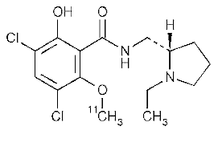
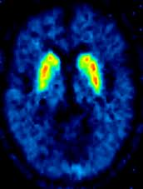
Dopamine Release During Cocaine Craving
PET Scanning
[¹¹C]Raclopride
radiotracer for D2-type
dopamine receptors
dopamine receptors
visualized with PET
Cocaine-related cues

Slide 17
Dopamine Release During Cocaine Craving
PET Scanning
[¹¹C]Raclopride
radiotracer for D2-type
dopamine receptors
dopamine receptors
visualized with PET
If dopamine increases in the synapse,
it competes with the tracer – so the tracer binds less.
Decreased binding reflects dopamine release.
Cocaine-related cues

Slide 18
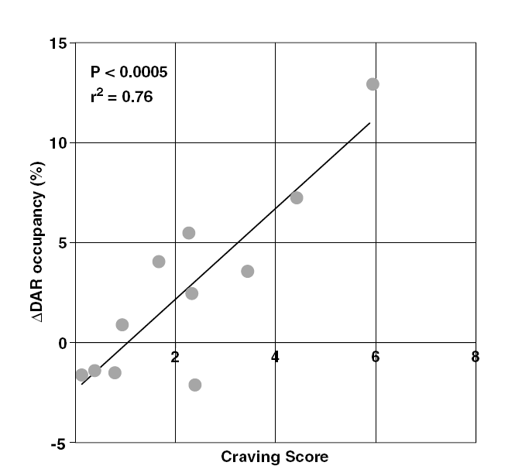
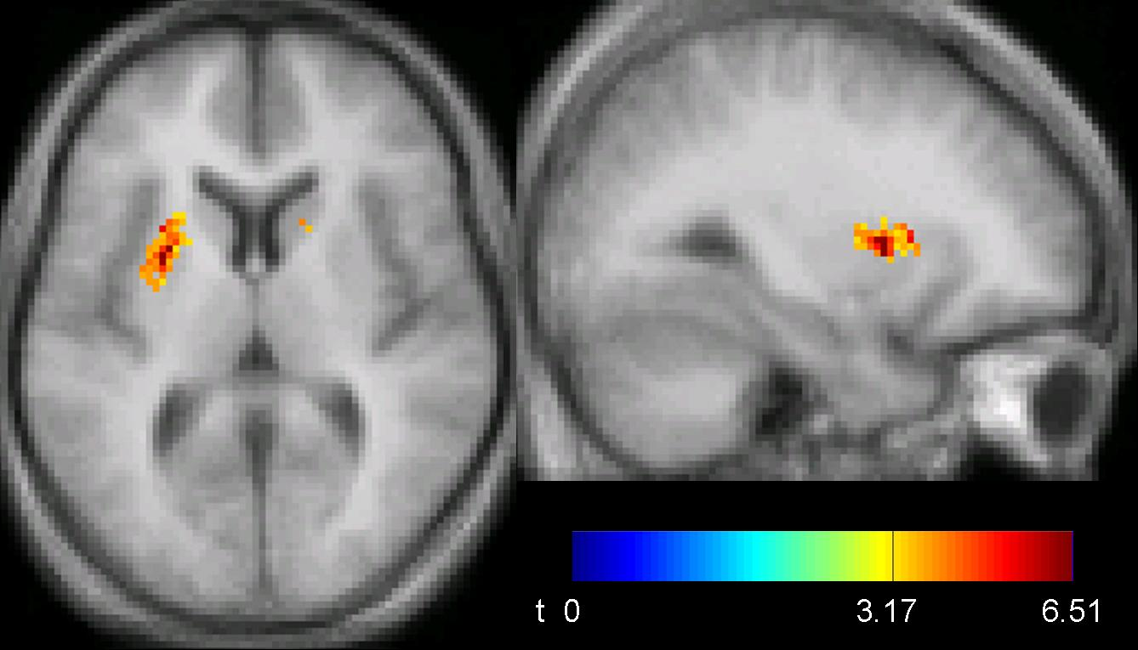
Cocaine Craving Linked to Dopamine Release
Studies of [¹¹C]Raclopride Binding to D2/D3 DA Receptors
The maps show regions
where DA release is related to craving.
Dopamine release in dorsal striatum
is correlated with craving.
∆ DA Receptor Occupancy (%)
p < 0.0005
r² = 0.76
Participants who craved the most had the
most DA release
Craving score
D.F. Wong et al. Neuropsychopharmacology, 2006
N.D. Volkow et al., J. Neurosci., 2006
Notes:
Another report by Nora Volkow, the Brookhaven group and collaborators at the U Penn showed as well that cocaine–related cues induced DAR in caudate & putamen but not n. accumbens that was related to craving score.

Slide 19
Smoking-Induces Dopamine Release in Striatum
∆ Binding Potential in Ventral Striatum
[C-11]Raclopride Binding to
D2/D3 Dopamine Receptors
0.5
0.0
-0.5
-1.0
-1.5
Before
After
Bq/ml
-2.0
0
1.5 x10⁻⁴
-2.5
No-Smoking
Smoking
A.M. Brody et al. Am J. Psychiatry, 2004
D.J. Scott et al. Neuropsychopharmacology, 2007

Slide 20
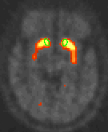
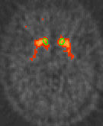
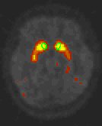
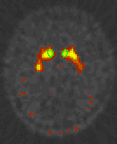
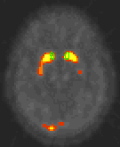
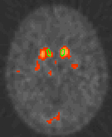
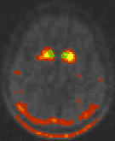
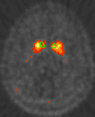
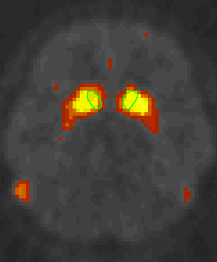
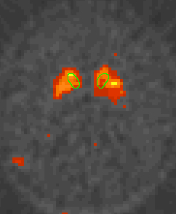
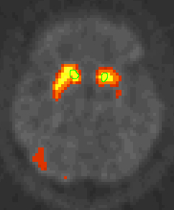
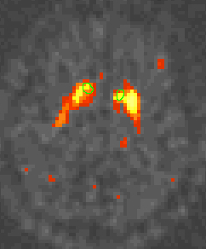
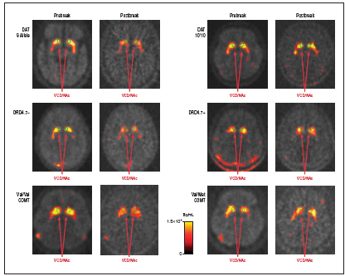
Genetic Control of Smoking-Induced Dopamine
Before
After
Before
After
DAT
9R+
DAT 9R-
DRD4
7-
DRD4
7+
COMT
Val/Val
COMT
Val/Met
Bq/ml
15X10⁴
0
Some genotypes associated
with DA release from smoking.
Other genotypes not associated
with DA release from smoking.
A.L. Brody et al. Arch. Gen. Psychiatry, 2006

Slide 21
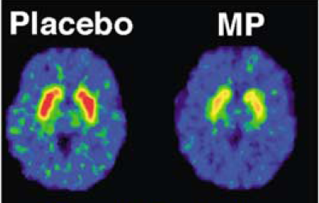
Drug-Induced Euphoria is
Related to Dopamine Release
5 min after IV Methylphenidate
Placebo
Placebo
MP
10
8
6
“High”
4
2
0
-10
0
10
20
30
40
Relative Change in Dopamine
[¹¹C]Raclopride binds to dopamine receptors.
Methylphenidate increases dopamine in the synapse.
Dopamine competes with the tracer – so the tracer binds less.
Decrease in binding is related to “high.”
N.D. Volkow et al. Mol. Psychiatry, 2004

Slide 22
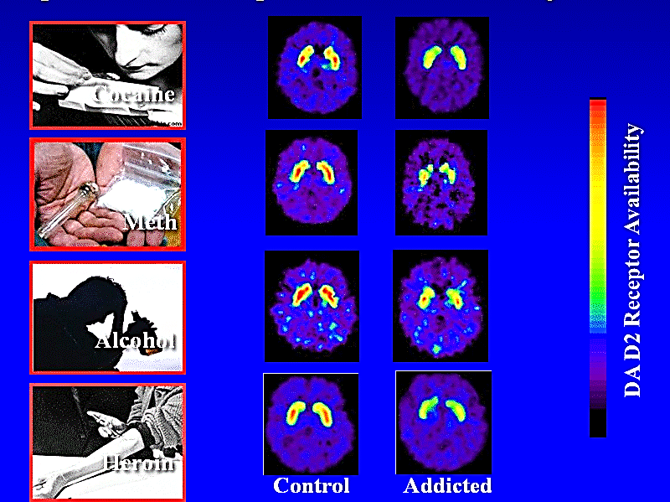
Striatal D2 Receptor in Multiple Addictions
N. Volkow et al., Brookhaven National Laboratory

Slide 23
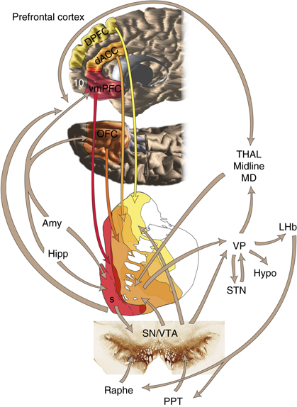
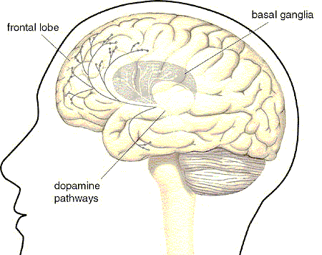
Frontostriatal System Controls
Executive Functions
Notes:
These systems support the executive control of behavior as well as motivationally driven behaviors and may contribute to vulnerabilities in the emergence of addicition pathology. Movement, cognition, behavior,

Slide 24
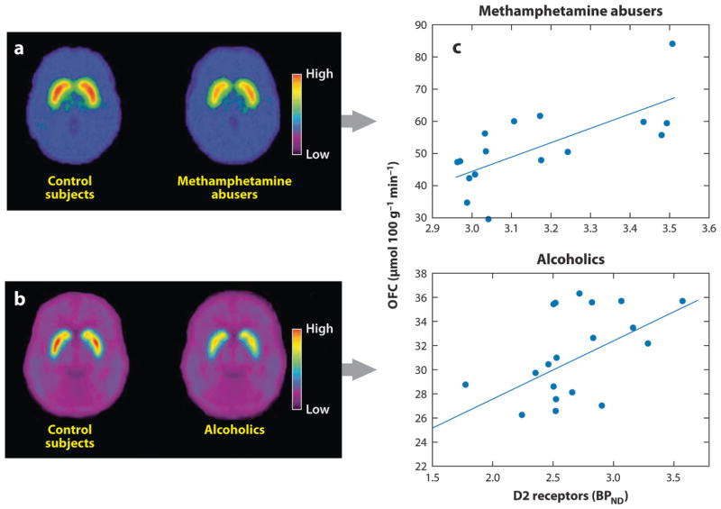
Dopamine Receptors in Striatum are Linked to Metabolism in Orbitofrontal Cortex
Control
METH Users
Glucose Metabolism in Orbitofrontal Cortex
Control
Alcoholic
Dopamine Receptor Availability in Striatum

Slide 25
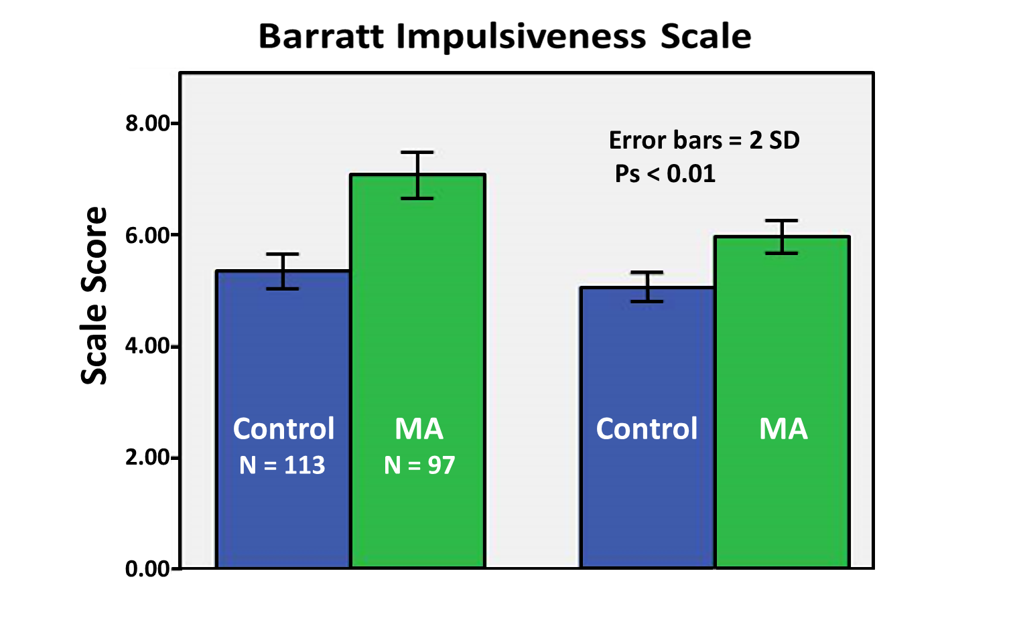
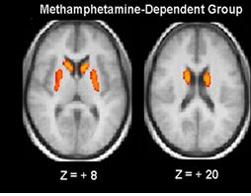

Negative Correlation of D2-type Receptor Binding with Impulsivity in METH Users
Methamphetamine-Dependent
Cognitive Behavioral
B Lee et al., J Neurosci, 2009

Slide 26

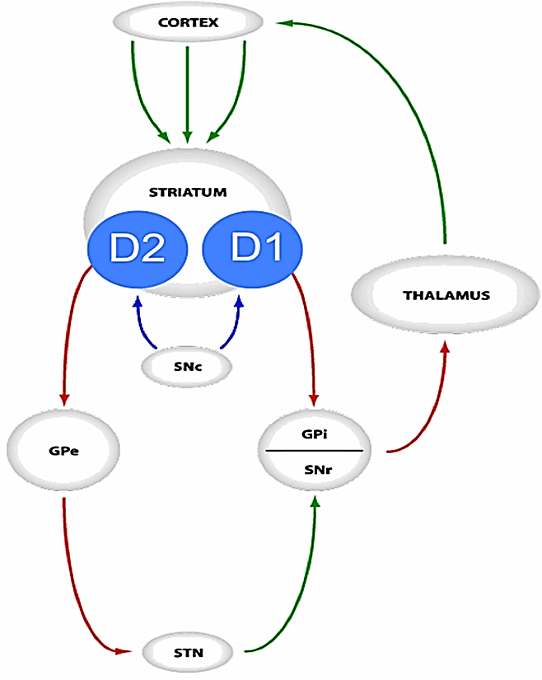
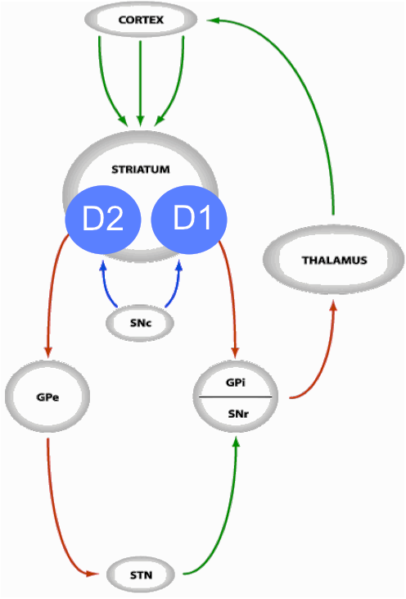

Dopamine Receptors and Self-Control
Opposing Pathways
CORTEX
Corticospinal pathway
STRIATUM
STRIATUM
THALAMUS
THALAMUS
SNc
SNc
GPi
GPi
GPe
GPe
SNr
SNr
Direct Pathway
“go”
Indirect Pathway
“no-go”
STN
STN
Adapted from Logan and Cowan, 1984
Notes:
Cortex (stimulates) → Striatum (inhibits) → "SNr-GPi" complex (less inhibition of thalamus) → Thalamus(stimulates) → Cortex (stimulates) → Muscles, etc. → (hyperkinetic state)
In the direct pathway, cortical cells project excitatory inputs to striatum, which in turn projects inhibitory neurons onto cells of SNr-GPi complex. The SNr-GPi complex projects directly onto the thalamus through inhibitory ansa lenticularis pathway. The striatal inhibition of the SNr-GPi complex reduces SNr-GPi inhibition of the thalamus -- therefore results in a net reduction of inhibition of the thalamus via the striatum. The thalamus projects excitatory glutamatergic neurons to the cortex itself. The direct pathway, therefore, results in the excitation of the motor cortex by the thalamus. Once stimulated, the cortex projects its own excitatory outputs to the brain stem and ultimately muscle fibers via the lateral corticospinal tract.

Slide 27
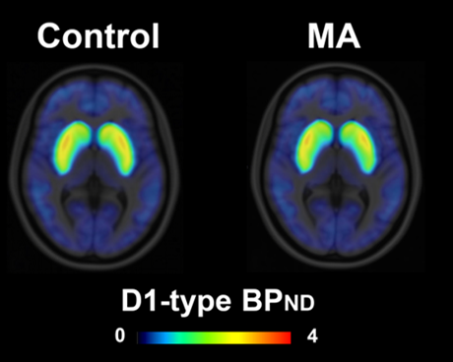





Disproportionate Effect on Dopamine Receptors
METH
METH
D1-type Receptors
D2-type Receptors
METH
METH
K. Okita et al., Mol Psychiatry 2018

Slide 28
Disproportionate Effect on Dopamine Receptors
METH
METH
D1-type Receptors
D2-type Receptors
METH
METH
Imbalance in direct and indirect pathways?
K. Okita et al., Mol Psychiatry 2018

Slide 29

Functional MRI Reflects Changes in
Blood Flow with Increased Brain Activity
Basal State Activated State

Slide 30
Imaging the Acute Effects of Cocaine
cocaine
NAc SCC
saline
(+ 12 mm)
Amygdala
(- 3mm)
BF/GP
(0 mm)
H.C. Breiter et al.
Neuron, 1997
VT(SN)
( -15mm)

Slide 31

Predicting Treatment Outcome
Stimulant-dependent participants underwent fMRI during “decision-making.”
Will a car appear on the left or the right side of the house?
Non-relapsers activated key
areas of cortex and striatum
& stayed in treatment.
1
Nonrelapsers
Relapsers
4
1
R Insula
Relapsers
did not activate.
2
R Inf Parietal
3
3
R Middle Temporal
4
L Caudate/Putamen
5
L Cingulate
-0.3 -0.2 -0.1 0 0.1 0.2 0.3 0.4 0.5
% Change in fMRI Signal
5
2
M.P. Paulus et al. Arch. Gen. Psychiatry, 2005

Slide 32


Stop-Signal Task

Stimulus
< , >
Response
0 ms
~500 ms
Go RT
SSRT
GD Logan et al.:
J Exp Psychol Hum Percept Perform, 1984.
Notes:
32
32

Slide 33

Methamphetamine Users Show a
Deficit on the Stop-Signal Task
Stop-Signal Reaction Time (msec)
METH Use (ln grams/wk)
Control
METH Users
J Monterosso et al., Drug Alcohol Depend, 2005
Notes:
LABEL
Grater stopping ability
Increasd arrows on axises
33

Slide 34




Dopamine D2-type Receptor Availability
Related to Stopping Ability
A
R
Caudate Putamen
Caudate
C
Putamen
300
260
220
180
140
r = -0.57
300
260
220
180
140
r = -0.50
SSRT (msec)
SSRT (msec)
12 16 20 24
6 18 20 22 24 26 28 30
DA D₂-type Receptor Availability
[¹⁸F]Fallypride PET in Healthy Controls
p<0.1
p<0.02
D Ghahremani et al., J. Neurosci., 2012
Notes:
CORRELATION OF BIOCHEMICAL MARKER WITH BEHAVIOR.

Slide 35


D2-type Receptor Availability Related to Frontostriatal Activity during Inhibition
fMRI and [¹⁸F]Fallypride PET in Healthy Controls
R
Z
3.96
Caudate Stop vs. Go
parameter estimates
1.96
r = 0.82
Caudate D2/D3 Receptor Availability
D Ghahremani et al., J. Neurosci., 2012
Ghahremani et al., under review
Notes:
CORRELATION OF BIOCHEMICAL MARKER WITH FUNCTIONAL ACTIVITY – BOLD fMRI

Slide 36






Impulsivity, Risk, Decision-Making and Addiction
Decision-Making Decision-Making
in the Lab in the Real World
Intra-Individual
States
Inter-Individual
Factors
Functional
Neuromaps
Escalating Drug Use
High Risk
Low Risk
Drug
Sobriety
Cognitive Models
Risky Sexual Behavior
Criminal
Legal
High Gain
Higher Loss
Low Gain
Lower Loss
Self-Reports
Illegal Behavior
HIV Risk
HIV Safe
Low Gain
Immediate
High Gain
Delayed
Task Behavior
Treatment Outcome
Lab Measures
Field Measures
H Ekhtiari et al., Curr. Opinion in Behav. Sci. (2017); 13:25–33

Slide 37




The Balloon Analogue Risk Task
Total $ 0.00
$ 0.75
Parametric analysis to test linear relationship between pump number and brain activation

Slide 38





Modulation of Risk-Taking
Frontal and Striatal Interaction
Modulation of activation
When taking risk
r = 0.770
Striatal D2-type receptor availability
When Cashing Out
r = 0.752
R
Striatal D2-type receptor availability
M Kohno et al., Cerebral Cortex, 2013
Notes:
Negative association of BPnd with modulation of DLPFC activation
and with earnings.
Positive association of BPnd with modulation of VSTR activation.

Slide 39

METH Users Have Abnormal Response to
Risk During Decision-Making
Prefrontal cortex
N. Accumbens
Ventral Striatum
Activity is modulated
by risk only in
healthy subjects.
More modulation by risk in METH users than
healthy subjects.
M Kohno et al., JAMA Psychiatry 2014

Slide 40
What Have We Learned?
Structural imaging (MRI)
smaller volume/thickness in many brain regions
greatest effects linked to alcohol
general effects: insula, orbitofrontal cortex
evidence for predisposing factors &
for effects on brain development
Molecular imaging (PET)
prefrontal cortex and amygdala in craving
craving and acute effects of drugs involve dopamine release
imbalance of D1- vs. D2-type dopamine receptors
Functional MRI
cortical activity predicts treatment outcome
cortical activity, linked to D2 receptor availability,
determines inhibitory control and adaptive decision-making

Slide 41
What Have We Learned?
Structural imaging (MRI)
smaller volume/thickness in many brain regions
greatest effects linked to alcohol
general effects: insula, orbitofrontal cortex
evidence for predisposing factors &
for effects on brain development
Molecular imaging (PET)
prefrontal cortex and amygdala in craving
craving and acute effects of drugs involve dopamine release
imbalance of D1- vs. D2-type dopamine receptors
Functional MRI
cortical activity predicts treatment outcome
cortical activity, linked to D2 receptor availability,
determines inhibitory control and adaptive decision-making
Medications that reduce signaling through D2 receptors may
compromise executive functions in individuals with D2 deficits.

Slide 42
Medications that Affect Dopamine Signaling
Antipsychotics
Olanzapine (D₂ receptor antagonist)
Risperidone (D₂ receptor antagonist, also D1 receptor antagonist)
Aripiprazole (antagonist at some D₂ receptors , partial agonist at others)
Lithium (alters function of certain DA-associated G-protein subunits)
Sleep/anxiolytic
• Quetiapine (D₁D₂, D₃, D₄ and D₅ receptor antagonist)
Hydroxyzine (weak D₂ receptor antagonist)
Buspirone (weak D₂ receptor antagonist)

Slide 43
What Have We Learned?
Structural imaging (MRI)
smaller volume/thickness in many brain regions
greatest effects linked to alcohol
general effects: insula, orbitofrontal cortex
evidence for predisposing factors &
for effects on brain development
Molecular imaging (PET)
prefrontal cortex and amygdala in craving
craving and acute effects of drugs involve dopamine release
imbalance of D1- vs. D2-type dopamine receptors
Functional MRI
cortical activity predicts treatment outcome
cortical activity, linked to D2 receptor availability,
determines inhibitory control and adaptive decision-making
Increasing signaling through D2-type dopamine receptors
may improve clinical outcome.

Slide 44
What Have We Learned?
Structural imaging (MRI)
smaller volume/thickness in many brain regions
greatest effects linked to alcohol
general effects: insula, orbitofrontal cortex
evidence for predisposing factors &
for effects on brain development
Molecular imaging (PET)
prefrontal cortex and amygdala in craving
craving and acute effects of drugs involve dopamine release
imbalance of D1- vs. D2-type dopamine receptors
Functional MRI
cortical activity predicts treatment outcome
cortical activity, linked to D2 receptor availability,
determines inhibitory control and adaptive decision-making
Increasing signaling through D2-type dopamine receptors
may improve clinical outcome.

Slide 45



8 Weeks of Exercise Training
Upregulates D2-Type Receptors
Education Exercise
(n = 11) (n = 10)
*
BASELINE
8 WEEKS
*
p <0.01
*
Mean (± SEM) D2-type BP_{ND}
Mean (± SWM) D2-type BP_{ND}
Limbic
Associative
Sensory motor
Limbic
Associative
Sensory motor
CL Robertson et al., 2016

Slide 46
Randomized Controlled Trial: Exercise vs. Health Education
Stimulant Reduction Intervention Using Dosed Exercise (STRIDE) Study
9 residential treatment programs
DSM-IV Stimulant Abuse, Dependence:
cocaine, MA, amphetamine
Education (n = 150) and Exercise (152)
12 wk acute intervention – began in residential treatment
wk 4 – 12 of the acute phase (nonresidential)
+ 24 wk additional intervention with FU
Outcome – percent stimulant abstinent days (TLFB, UDS)
In primary analysis, no significant group difference.
MH Trivedi et al., J Clin Psychiatry 2017

Slide 47

Adjusted for Adherence and Prior Use
1.0
0.8
0.6
0.4
0.2
0.0
Proportion of Days Abstinent
Exercise
Health Education
Health Education
Exercise
0 10 20 30 40 50 60 70 80 90 100
Percent of Sessions Attended

Slide 48
Adjusted for Adherence and Prior Use
1.0
0.8
0.6
0.4
0.2
0.0
Proportion of Days Abstinent
Exercise
Health Education
Exercise may improve outcomes.
Health Education
Exercise
0 10 20 30 40 50 60 70 80 90 100
Percent of Sessions Attended

Slide 49

Brain Imaging to Inform Treatments
Using Electrical Brain Stimulation
Preliminary Study in Smokers. One session of over the left DLPFC reduced brain activity in nucleus accumbens (A) and medial orbitofrontal cortex (B). Bar graph shows the mean BOLD signals (beta value ± SE), left NAc (−6, 8, −8) (C) and right mOFC (18, 29, −11) (D). N = 10, *p < .05, **p < .01.
X. Li et al., Am. J. Addictions, 2017

Slide 50

Sex Differences in Smoking Cessation Success and in Brain Responses to Smoking
Greater Dopamine Release in
Ventral Striatum of Men vs. Women
Given sex differences in neuroanatomical response to smoking,
treatments involving brain stimulation might need to be tailored to the
sex of the patient.
KP Cosgrove et al., J Neurosci 2014

Slide 51
Acknowledgements
London Lab
Dara Ghahremani
Andrew C. Dean
Buyean Lee
John Monterosso
Todd Zorick
Kenji Ishibashi
Milky Kohno
Angelica Morales
Kyoji Okita
Doris Payer
Chelsea L. Robertson
Golnaz Tabibnia
Integrated Substance
Abuse Programs
Walter Ling
Karen Miotto
Larissa Mooney
Rick Rawson
Joy Chudsinski
Semel Institute Stat Core
Catherine Sugar
Gerhard Hellemann
Consortium for
Neuropsychiatric Phenomics
Robert Bilder
Russell Poldrack
Tyrone Cannon
VA PET Lab
Judah Farahi
Mark A. Mandelkern
Support from the National Institute on Drug Abuse:
Training Grant: T32 DA024635
Research Grants: DA 15179, DA024853, DA020726, DA022539 (London),
DA027633 (Rawson), DA027734 (Dean).
Endowments: Pike Chair in Addiction Studies, Marjorie Green Family Trust

